Slide 1
Computer Architecture
Lecture 04
Computer Arithmetic &
Instruction Set
Instructor: Tapushe Rabaya Toma
Sr. Lecturer, SWE, DIU

Slide 2
Reference Books
Computer Organization and Architecture: Designing for Performance- William Stallings (8th Edition)
Any later edition is fine

Slide 3
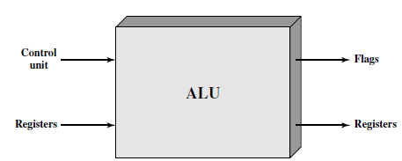
ALU
Data are presented to the ALU in registers, and the results of an operation are stored in registers
The ALU may also set flags as the result of an operation
The flag values are also stored in registers within the processor
The control unit provides signals that control the operation of the ALU and the movement of the data into and out of the ALU

Slide 4
Number Representation (Fixed Point)
Integer Representation
Straight forward, can not present signed numbers
Sign-Magnitude Representation
If the sign bit is 0, the number is positive; if the sign bit is 1, the number is negative
Disadvantages:
Addition and subtraction require a consideration of both the signs of the numbers and their relative magnitudes to carry out the required operation
There are two representations of 0

Slide 5
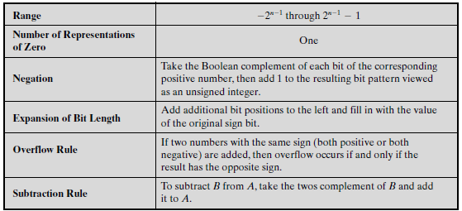
Number Representation (Fixed Point)
Twos Complement Representation
Mostly used

Slide 6



Converting between Different Bit Lengths
This is called sign extension

Slide 7
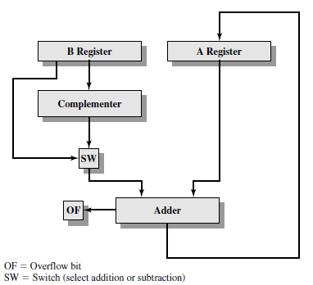
Block Diagram of Hardware for Addition and Subtraction

Slide 8
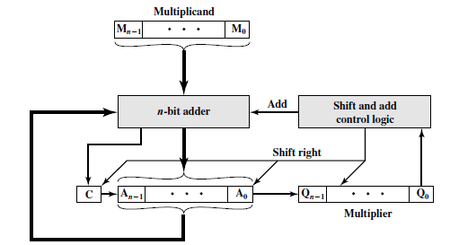
Multiplication Implementation

Slide 9
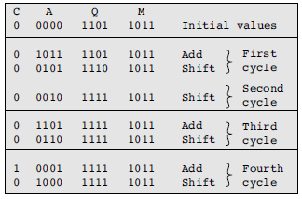
Multiplication Implementation

Slide 10
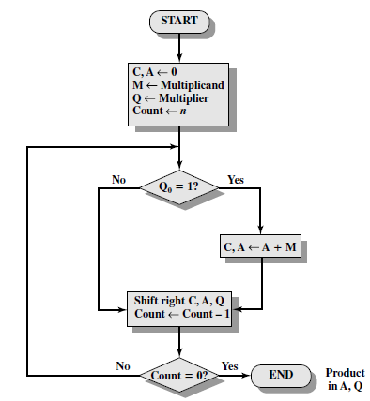
Multiplication (Unsigned) Implementation

Slide 11
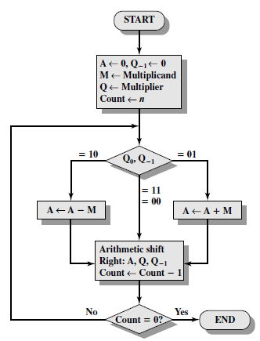
Multiplication (2’s Complement) Implementation

Slide 12
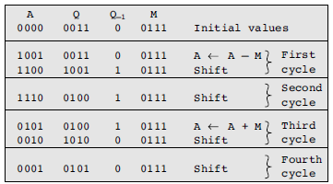
Multiplication (2’s Complement) Implementation

Slide 13
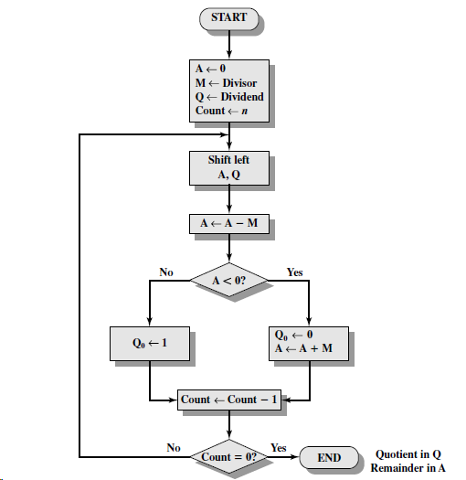
Flowchart for Unsigned Binary Division

Slide 14
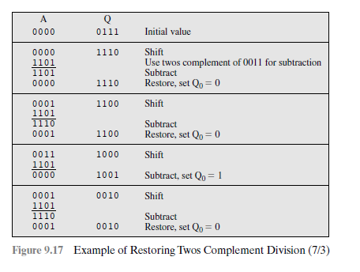

Slide 15
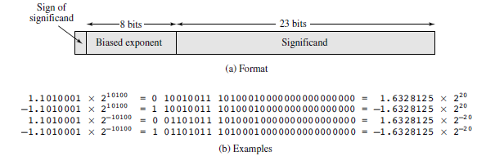
Floating-Point Representation Format

Slide 16
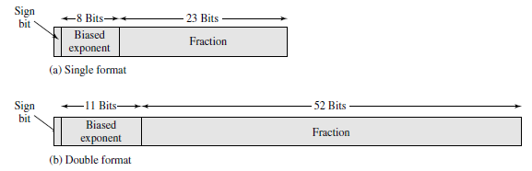
IEEE Standard for Binary Floating-Point Representation

Slide 17
Machine Instruction Characteristics
Instructions it executes
The collection of different instructions that the processor can execute is referred to as the processor’s instruction set
4 Basic elements of an machine instruction
Operation code
Source operand reference
Result operand reference
Next instruction reference

Slide 18
Elements of a Machine Instruction
Operation code: Specifies the operation to be performed (e.g., ADD, I/O)
The operation is specified by a binary code, known as the operation code, or opcode
Source operand reference: The operation may involve one or more source operands, that is, operands that are inputs for the operation
Result operand reference: The operation may produce a result
Next instruction reference: This tells the processor where to fetch the next instruction after the execution of this instruction is complete

Slide 19
Elements of a Machine Instruction
The address of the next instruction could be either-
real address or
a virtual address
Depends on architecture
Source and result operands can be in one of four areas:
Main or virtual memory: As with next instruction references, the main or virtual memory address must be supplied
Processor register: With rare exceptions, a processor contains one or more registers that may be referenced by machine instructions
If only one register exists, reference to it may be implicit
If more than one register exists, then each register is assigned a unique name or number, and the instruction must contain the number of the desired register

Slide 20
Elements of a Machine Instruction
Immediate: The value of the operand is contained in a field in the instruction being executed
I/O device: The instruction must specify the I/O module and device for the operation
If memory-mapped I/O is used, this is just another main or virtual memory address

Slide 21
Instruction Representation
Each instruction is represented by a sequence of bits, within a computer
The instruction is divided into fields, corresponding to the constituent elements of the instruction
Opcodes are represented by abbreviations, called mnemonics, that indicate the operation
Some common examples-
ADD | Addition
SUB | Subtraction
DIV | Division
LOAD | Load data from memory
STOR | Store data to memory

Slide 22
Instruction Representation
Operands are also represented symbolically
Example: ADD R, Y

Slide 23
Instruction Types
A typical high level instruction
X = X + Y
How is it done in low level/machine language?
A computer should have a set of instructions that allows the user to formulate any data processing task
The set of machine instructions must be sufficient to express any of the instructions from a high-level language
Basic types-
Arithmetic instructions
Logic (Boolean) instructions
memory instructions
I/O instructions
Test instructions
Branch instructions

Slide 24
Number of Addresses
Arithmetic and logic instructions will require the most operands
Virtually all arithmetic and logic operations are either unary (one source operand) or binary (two source operands)
Thus, we would need a maximum of two addresses to reference source operands
The result of an operation must be stored, suggesting a third address, which defines a destination operand
Finally, after completion of an instruction, the next instruction must be fetched, and its address is needed
Zero-address instructions are applicable to a special memory organization, called a stack
Fewer addresses per instruction result in instructions that are more primitive, requiring a less complex processor

Slide 25
Number of Addresses
The design trade-offs involved in choosing the number of addresses per instruction are complicated by other factors
There is the issue of whether an address references a memory location or a register
Because there are fewer registers, fewer bits are needed for a register reference
A machine may offer a variety of addressing modes, and the specification of mode takes one or more bits
With one-address instructions, the programmer generally has available only one general-purpose register, the accumulator
With multiple-address instructions, it is common to have multiple general purpose registers

Slide 26
Instruction Set Design
Most fundamental issues include-
Operation repertoire: How many and which operations to provide, and how complex operations should be
Data types: The various types of data upon which operations are performed
Instruction format: Instruction length (in bits), number of addresses, size of various fields, and so on
Registers: Number of processor registers that can be referenced by instructions, and their use
Addressing: The mode or modes by which the address of an operand is specified

Slide 27
Types of Operands
Important general categories are-
Addresses
Numbers
Characters
Logical data

Slide 28
Types of Operations
General types-
Data transfer
Arithmetic
Logical
Conversion
I/O
System control
Transfer of control
Data Transfer: The data transfer instruction must specify several things
First, the location of the source and destination operands must be specified
Each location could be memory, a register, or the top of the stack
Second, the length of data to be transferred must be indicated
Third, as with all instructions with operands, the mode of addressing for each operand must be specified

Slide 29
Types of Operations
System Control
System control instructions are those that can be executed only while the processor is in a certain privileged state or is executing a program in a special privileged area of memory
Typically, these instructions are reserved for the use of the operating system
Transfer of Control
Why required?
In the practical use of computers, it is essential to be able to execute each instruction more than once and perhaps many thousands of times
It may require thousands or perhaps millions of instructions to implement an application
This would be unthinkable if each instruction had to be written out separately
If a table or a list of items is to be processed, a program loop is needed
One sequence of instructions is executed repeatedly to process all the data

Slide 30
Types of Operations
Virtually all programs involve some decision making
We would like the computer to do one thing if one condition holds, and another thing if another condition holds
For example, a sequence of instructions computes the square root of a number
At the start of the sequence, the sign of the number is tested
If the number is negative, the computation is not performed, but an error condition is reported
To compose correctly a large or even medium-size computer program is an exceedingly difficult task
It helps if there are mechanisms for breaking the task up into smaller pieces that can be worked on one at a time
Most common transfer-of-control operations found in instruction sets: branch, skip, and procedure call

Slide 31
Branch Instructions
A branch instruction, also called a jump instruction, has as one of its operands the address of the next instruction to be executed
Most often, the instruction is a conditional branch instruction
That is, the branch is made (update program counter to equal address specified in operand) only if a certain condition is met
Otherwise, the next instruction in sequence is executed (increment program counter as usual)
A branch instruction in which the branch is always taken is an unconditional branch
Two ways of doing this:
First, most machines provide a 1-bit or multiple-bit condition code that is set as the result of some operations
This code can be thought of as a short user-visible register
BRP X : Branch to location X if result is positive
BRN X :Branch to location X if result is negative

Slide 32
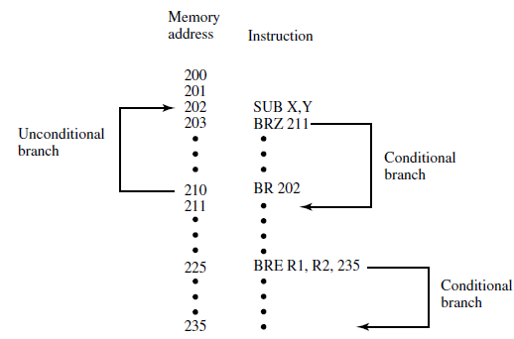
Branch Instructions
Another approach that can be used with a three-address instruction format is to perform a comparison and specify a branch in the same instruction
For example-
BRE R1, R2, X :Branch to X if contents of R1 = contents of R2
Fig: Branch Instructions

Slide 33
Skip Instructions
The skip instruction includes an implied address
Typically, the skip implies that one instruction be skipped; thus, the implied address equals the address of the next instruction plus one instruction length
Because the skip instruction does not require a destination address field, it is free to do other things
A typical example is the increment-and-skip-if-zero (ISZ) instruction

Slide 34
Procedure Call Instructions
A procedure is a self contained computer program that is incorporated into a larger program
At any point in the program the procedure may be invoked, or called
Used because of-
Economy and
Modularity
The procedure mechanism involves two basic instructions:
A call instruction that branches from the present location to the procedure, and a return instruction that returns from the procedure to the place from which it was called
Both of these are forms of branching instructions

Slide 35
Procedure Call Instructions
Important points:
A procedure can be called from more than one location
A procedure call can appear in a procedure
This allows the nesting of procedures to an arbitrary depth
Each procedure call is matched by a return in the called program

Slide 36
Multiplication of Unsigned with example
Twos Complement Integers with example
Branch instruction with example
Skip instruction with example

Slide 37
Thank you!

